Slide 1


Github
Optimization of routers placements in wireless mesh networks
phase B
Supervisor: Prof. Miri Weiss-Cohen 23-2-R-11
Presented By:
Omer Rogel Marom Blumenfeld

Slide 2
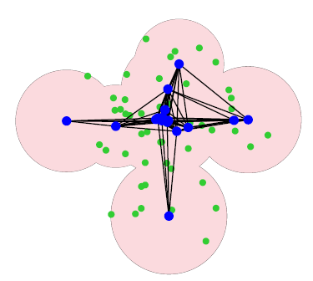
Project Overview
Our project focused on evaluating optimization algorithms for solving spatial router deployment challenges. The primary objective was to achieve a well-connected network layout that maximizes customer connectivity and robust inter-router connections, ensuring reliable WiFi coverage across the designated area.
Input Output
1. Number of routers.
2. Number of client.
(with location)
3. Area intended to be covered
(room/garden/public building).
Optimal deployment

Slide 3
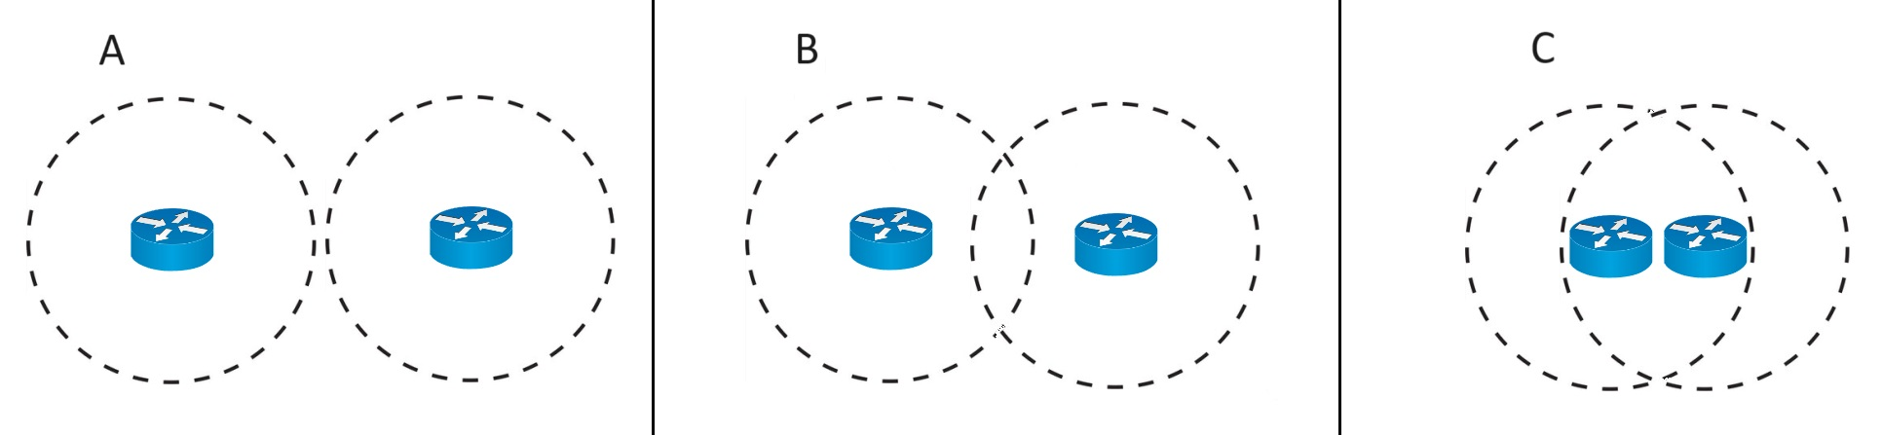
Router Connectivity Visualization
This key concept is the necessity for routers to be within transmission range of each other to establish a network.
Non-neighboring routers Non-neighboring routers Neighbor routers

Slide 4
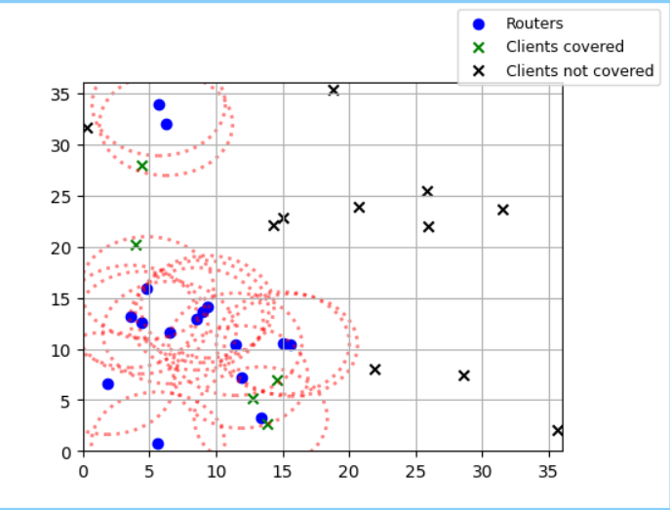
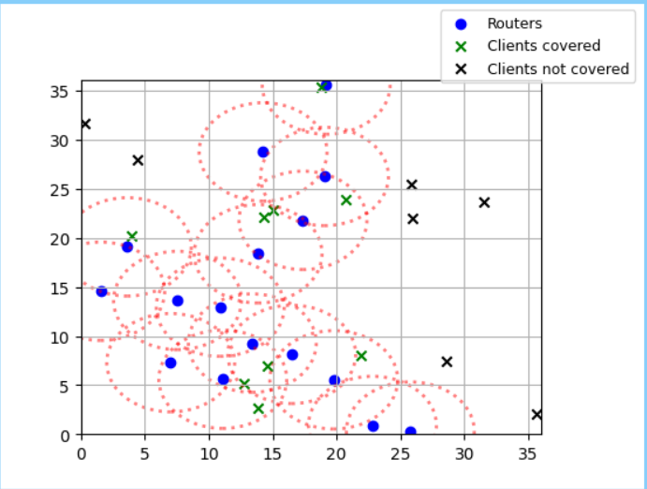
The need for developing
Addressing the need for efficient router placement in wireless mesh networks for optimal configuration and improve network performance.
Meeting the demand for reliable and scalable wireless networks in various applications.
Offering a user-friendly interface for easy use and understanding, making it accessible to a wide range of users.

Slide 5
Our system main demands
To develop a tool that could optimize the placement of routers in wireless mesh networks to improve network performance.
To create a user-friendly interface that could visualize the optimized router placements and provide insights into the network performance.
Notes:
עומר התחלה

Slide 6
Optimization Algorithms Selection
The decision to implement Genetic Algorithm (GA) and Particle Swarm Optimization (PSO) stemmed from their adaptability and effectiveness in searching for optimal solutions. GA leverages evolutionary principles, while PSO mimics swarming behavior to efficiently explore solution spaces. תמונה של ga and pso ?

Slide 7
Genetic Algorithm (GA) Overview
GA is an evolutionary optimization technique inspired by the principles of natural selection and genetic inheritance, it operates by iteratively evolving a population of candidate solutions using genetic operators

Slide 8
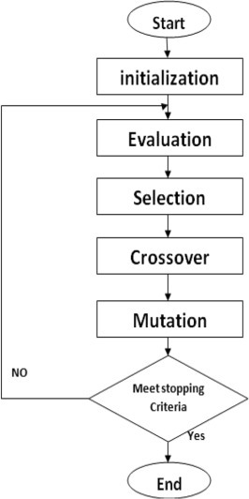
GA Flowchart
In each iteration of GA, potential solutions undergo selection based on fitness evaluation. Crossover and mutation operations generate new solutions, refining the population toward optimal configurations.

Slide 9
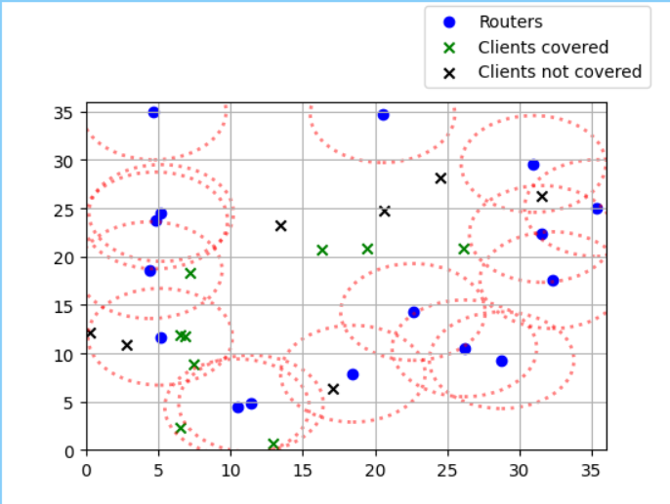
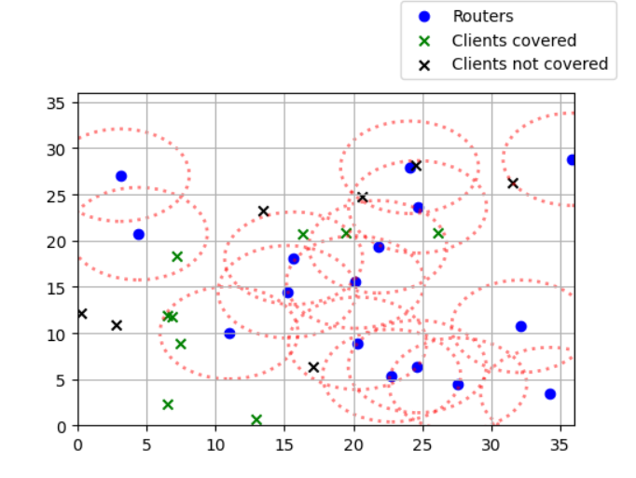
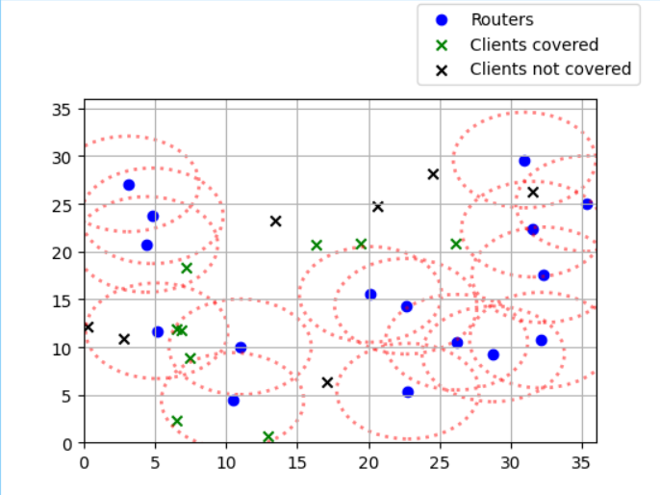
GA in our program
In the context of WMN, GA works by evolving a population of potential solutions, representing router placements, over generations. it is gradually improving the solutions' fitness until an optimal placement is found for the mesh network.
Notes:
עומר סוף

Slide 10
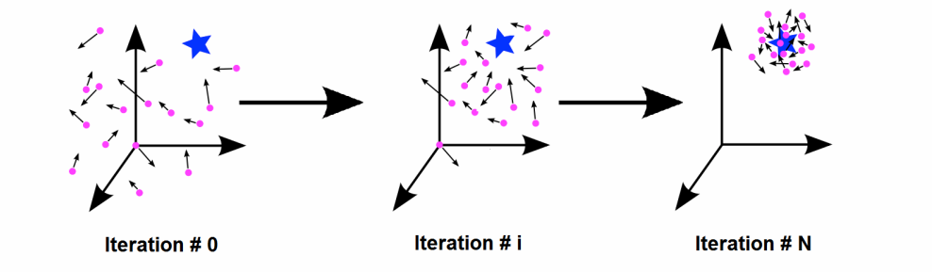
Particle Swarm Optimization (PSO) Overview
Particle Swarm Optimization (PSO) is a population-based optimization technique where particles (representing potential solutions) adjust their positions based on local and global best-known positions. This cooperative behavior enables efficient exploration of solution spaces.

Slide 11
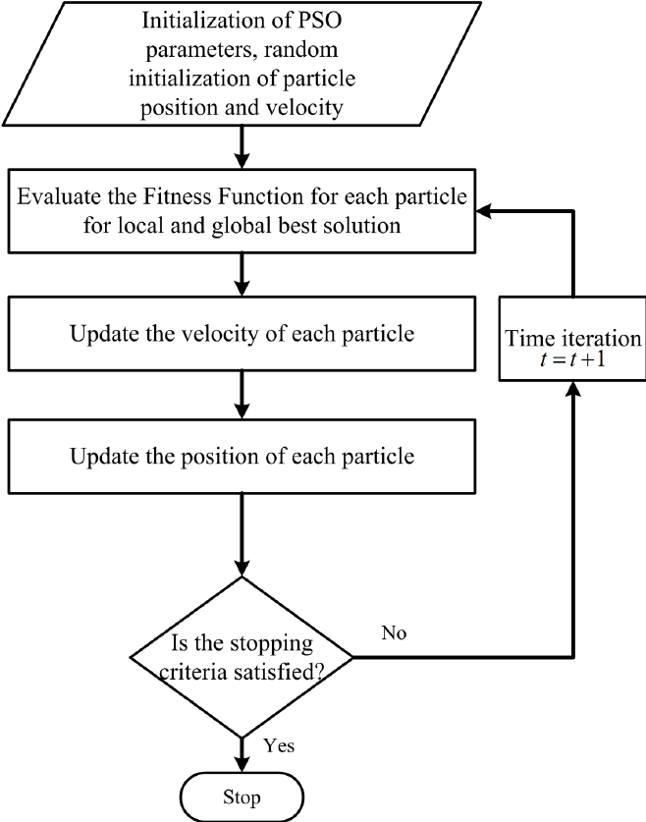
PSO Flowchart
PSO iteratively updates particle positions, emphasizing the balance between individual particle exploration and exploitation of promising solution areas. The algorithm dynamically adjusts particle velocities to converge toward optimal solutions.

Slide 12
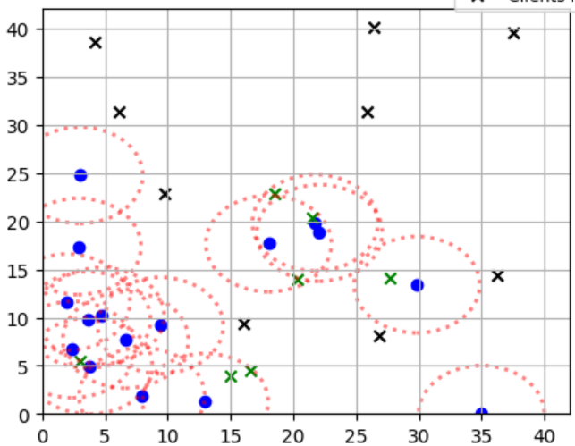
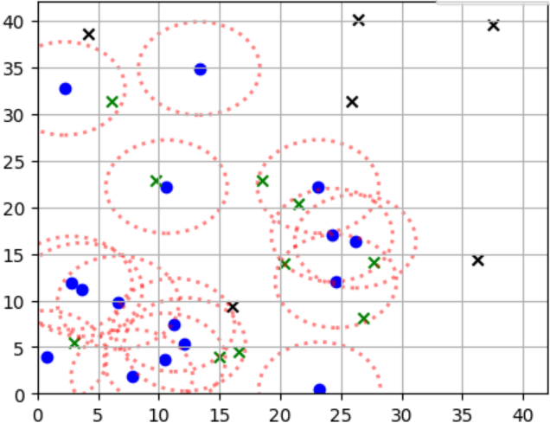
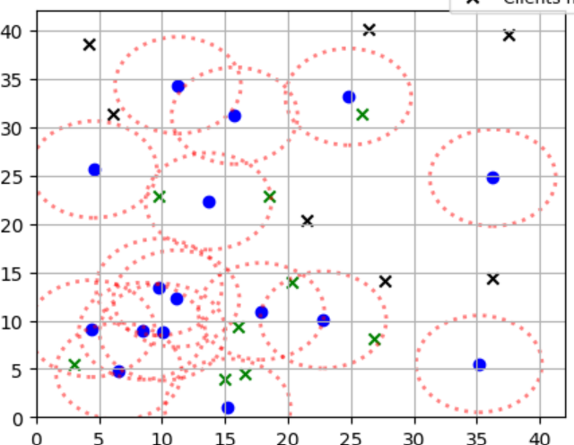
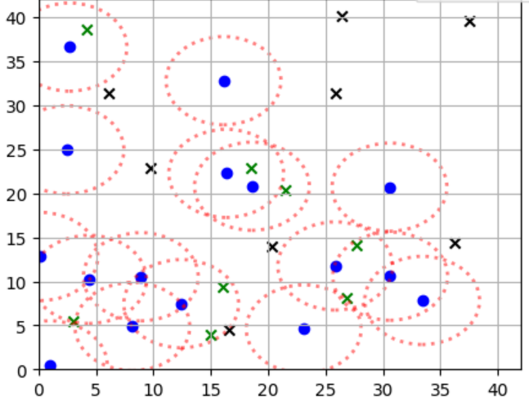
PSO Process
Iteration 5
Iteration 10
Iteration 20
Iteration 50

Slide 13
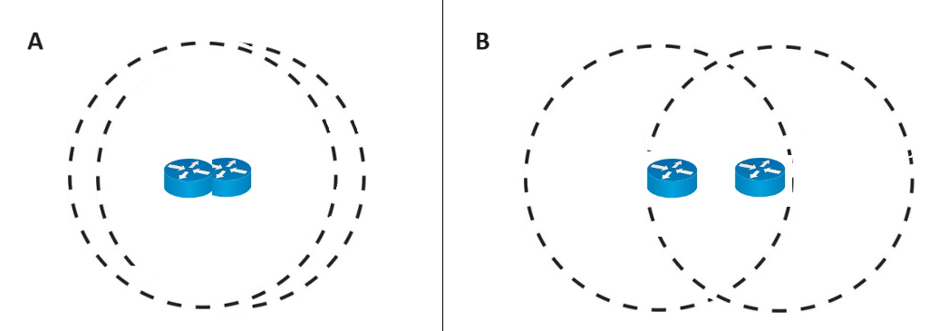
Fitness Function Design
The fitness function was designed to evaluate layout quality based on coverage percentage and connection component size. Additionally, we incentivized optimal router placement by rewarding configurations that maintain specific distances between routers, enhancing network efficiency.
The layout of the routers in Figure B is better than Figure A, so its score will be higher.

Slide 14


Software Development Tools
Our software was developed using Python along with libraries such as matplotlib, numpy, and tkinter. Python facilitated algorithm implementation and visualization, while matplotlib and tkinter enabled graphical representation and user interface development.

Slide 15
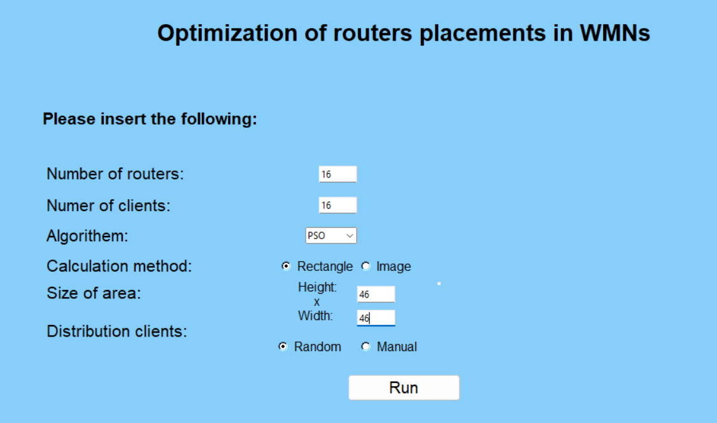
Our solution
We developed a software tool that optimizes the placement of routers in wireless mesh networks using Genetic Algorithm and Particle Swarm Optimization algorithm.
Notes:
עומר התחלה

Slide 16
Technologies that were used during development
Python was used as the primary programming language for its simplicity and extensive libraries for scientific computing.
We used Pycharm as our Python distribution.
Git was used for version control to manage code changes and collaboration between team members.
We utilized various Python libraries, including NumPy, math and random for numerical computing
The development of the Genetic Algorithm and Particle Swarm Optimization algorithms was done using Python.

Slide 17
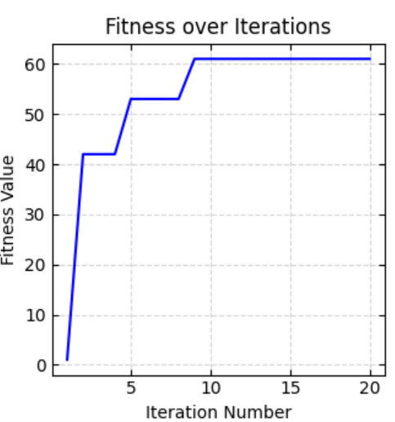
Technologies that were used inside the program
Matplotlib and tkinter was used to visualize the results of the optimization process, such as the placement of routers and network performance metrics.
Various data structures, such as arrays and dictionaries, were used to store and manage data related to routers, clients, and network metrics.
Iteration 20

Slide 18
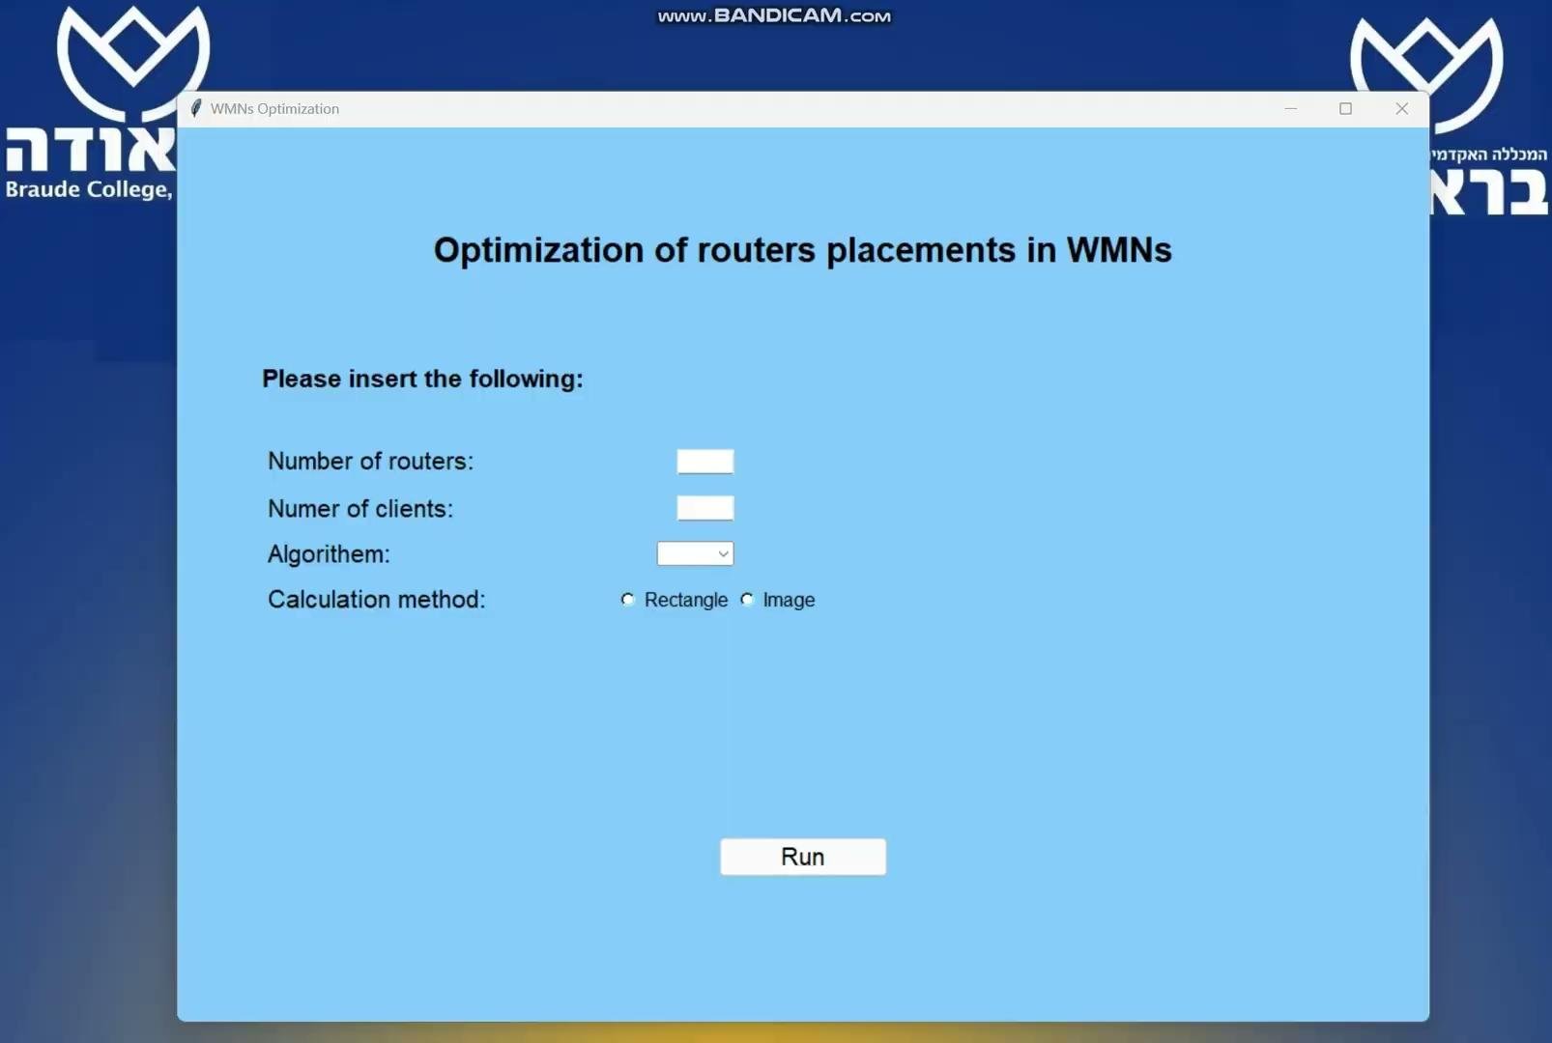
Software Demonstration Video
Notes:
עומר סוף

Slide 19
Results
Genetic Algorithm:
Leans towards client coverage over creating a single large mesh network.
Final output showed a fair distribution of routers in the sub-networks.
Particle swarm optimization:
Produced better results in terms of giant component size and overall network connectivity compared to GA.
PSO converges faster to an optimal solution, indicating its efficiency in navigating solution spaces.
Notes:
גרפים או טבלה להוסיף

Slide 20
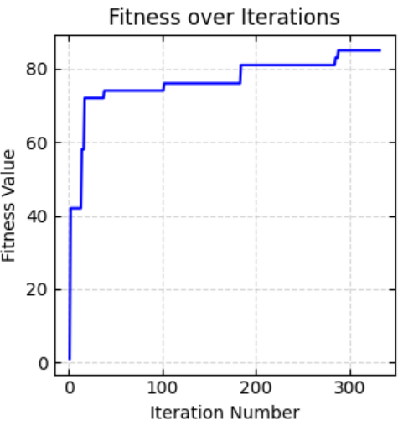
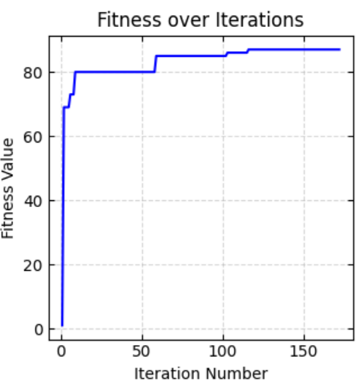
Results
GA: PSO:
Notes:
גרפים או טבלה להוסיף

Slide 21
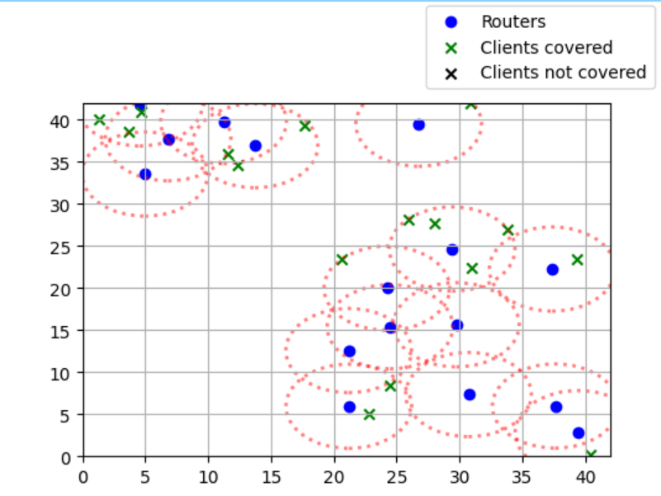
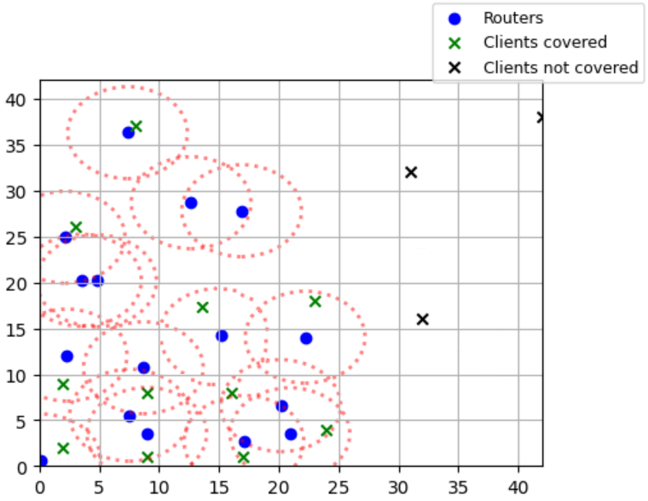
Results
GA after 300 iterations: PSO after 150 iterations:
Notes:
גרפים או טבלה להוסיף

Slide 22
Average results table
Algorithm | Iteration number | Size | Coverage | Giant component size | Fitness value
GA | 300 | 42x42 | 82% | 4 | 83.1%
PSO | 300 | 42x42 | 77% | 8 | 87.8%
Algorithm | Iteration number | Size | Coverage | Giant component size | Fitness value
GA | 300 | 36x36 | 89% | 6 | 88.3%
PSA | 300 | 36x36 | 83% | 9 | 92.8%

Slide 23
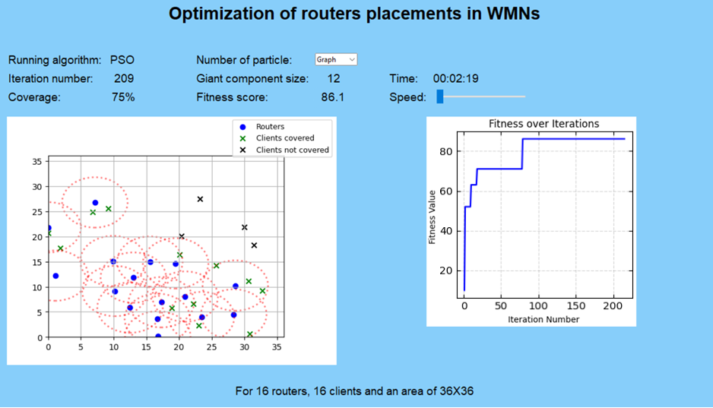
Result images
GA: PSO:
Notes:
עומר התחלה

Slide 24
Project goals
Develop a sophisticated algorithmic solution for optimizing the placement of routers in Wireless Mesh Networks using GA and PSO - achieved.
Create a software program with a user-friendly interface for intuitive interaction, providing insights into network performance and router placement strategies - achieved.
Enhance network coverage, minimize interference, and improve overall network throughput through optimized router placement - semi-achieved
Notes:
תובנות להסביר גם

Slide 25
Challenges and dealing with them
Understanding the underlying principles of GA and PSO - in-depth study of algorithmic complexities.
Implementing the GA and PSO algorithms in Python involved ensuring efficiency, scalability - a step by step coding and testing.
Establishing parameters and weights for the fitness function - careful tuning and evaluation to achieve an optimal solution.
Balancing the workload between team members - effective communication, and collaboration.

Slide 26
Conclusions
Genetic Algorithm:
Suitable for establishing multiple mesh networks in a desired area with several mesh clients.
Particle swarm optimization:
Recommended for a connected mesh network focused on connectivity over coverage.
A common conclusion drawn from the study is the necessity for each algorithm to have a unique fitness function.

Slide 27
Conclusions
We hypothesize that PSO's success can be attributed to its swarm-based approach, which efficiently explores solution spaces and adapts based on local and global information. In contrast, GA's reliance on evolutionary processes may have contributed to its slightly less optimal performance.

Slide 28
Thank You!
Notes:
עומר סוף

Slide 29
References
Rastin Pries, Barbara Staehle, Dirk Staehle, Phuoc Tran-Gia.(2010, January). On Optimization of Wireless Mesh Networks using Genetic Algorithms.
Tetsuya Oda, Aoto Hirata, Nobuki Saito ,Kazuho Kanahara.(2020, May). Approach of a Solution Construction Method for Mesh Router Placement Optimization Problem.
Shinji Sakamoto, Tetsuya Oda.(2016, April). Implementation and Evaluation of a Simulation System Based on Particle Swarm Optimization for Node Placement Problem in Wireless Mesh Networks.

